Slide 1


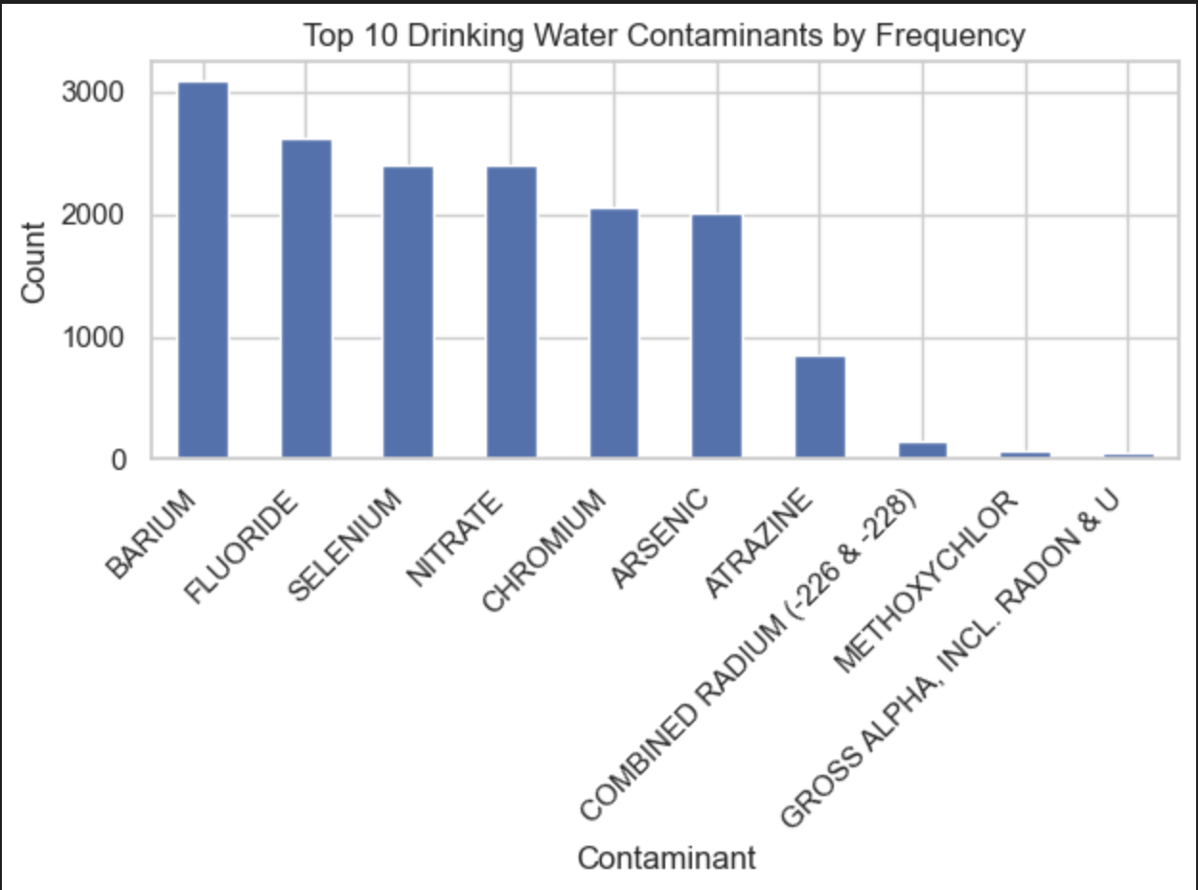
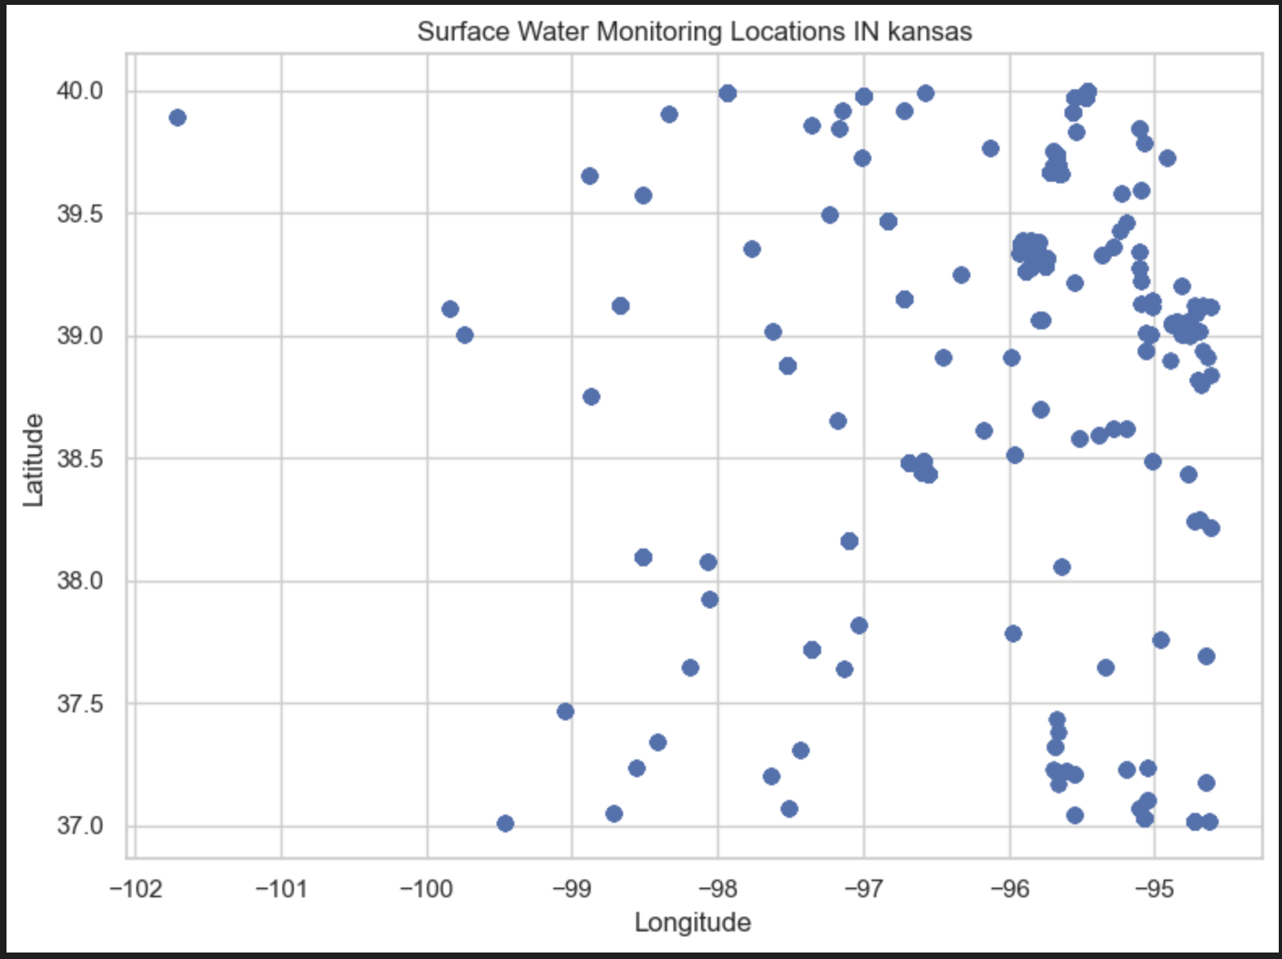
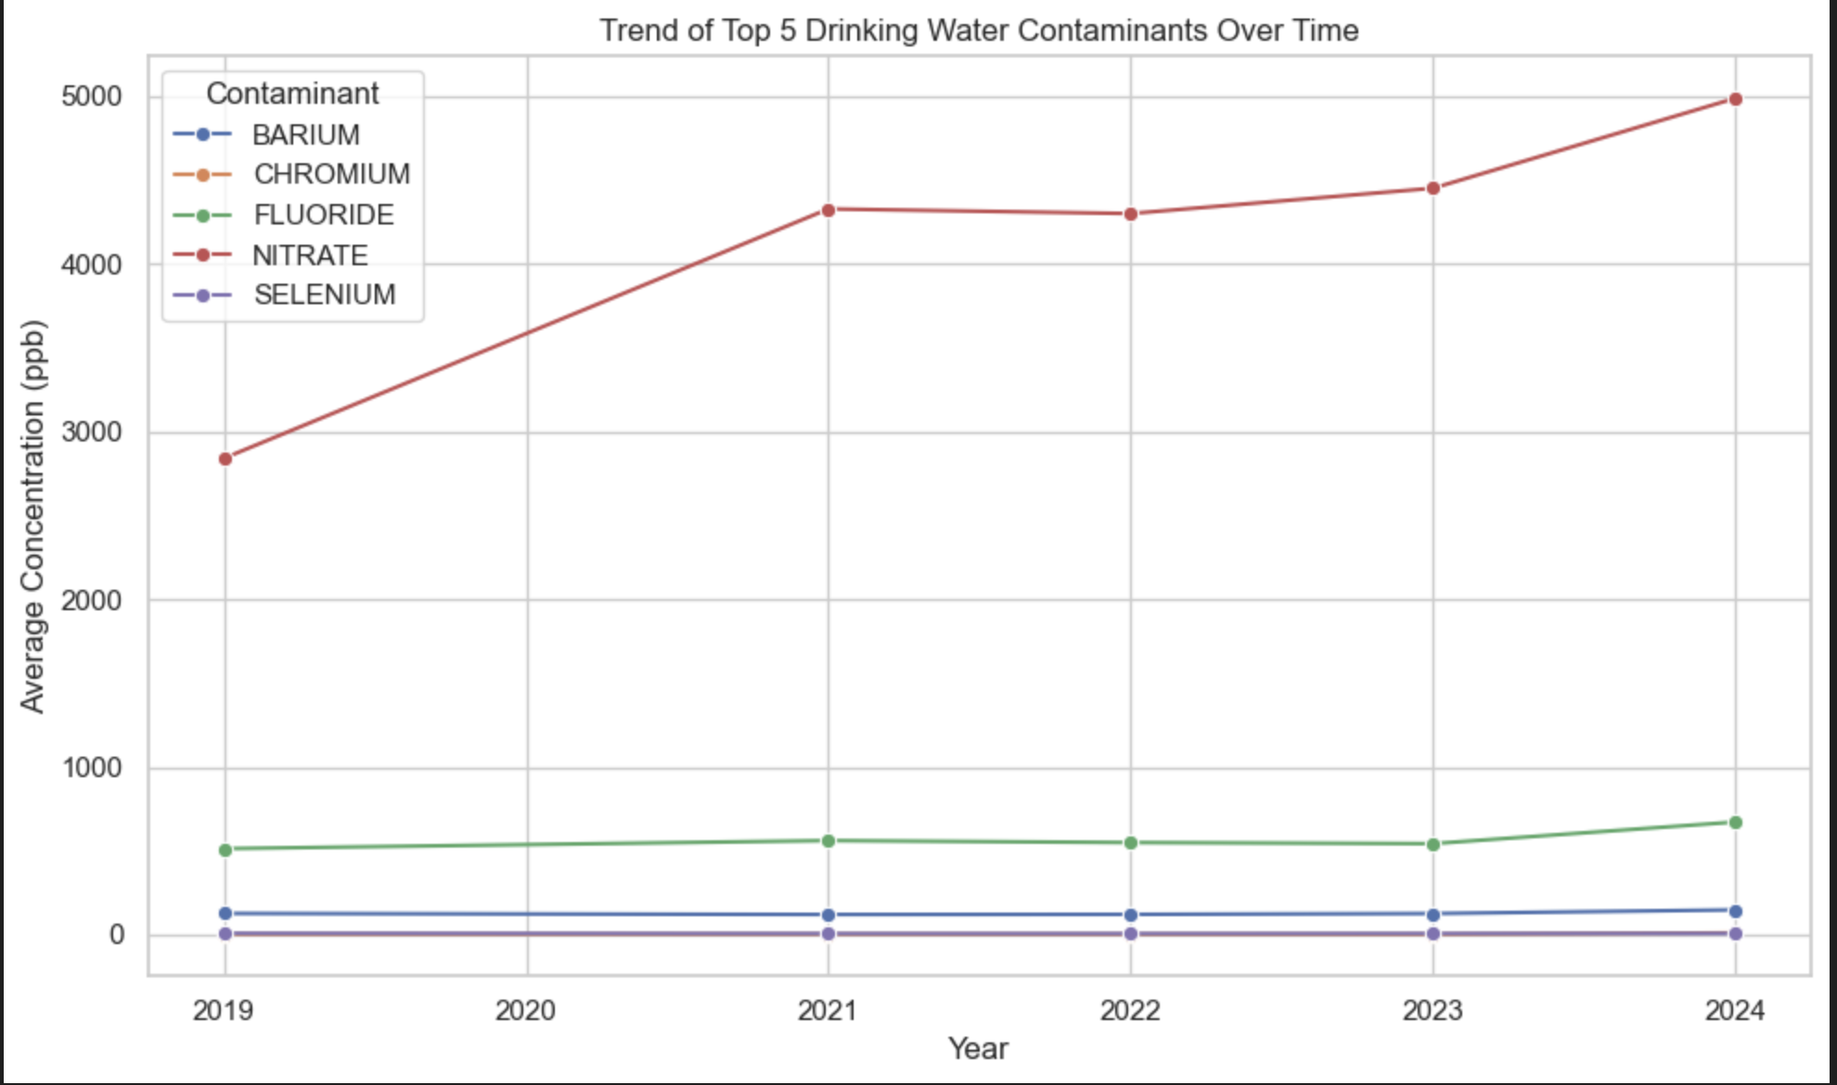
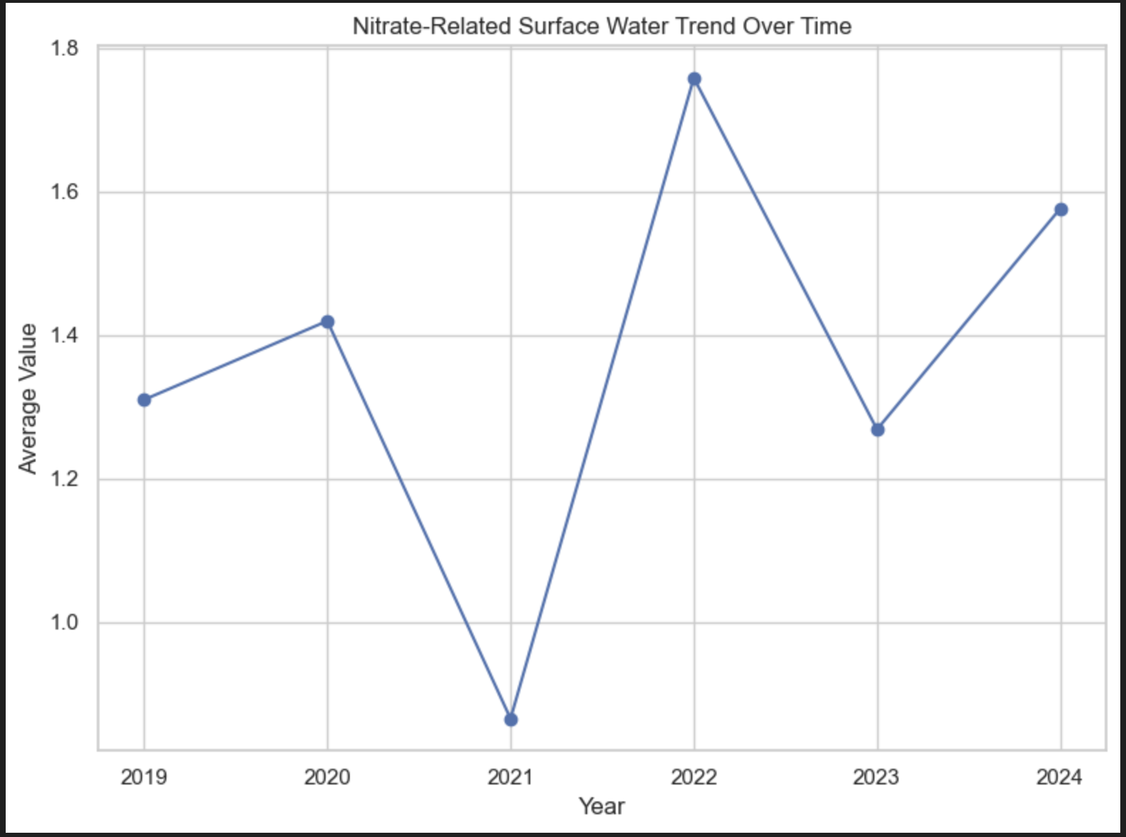
Surface Water and Drinking Water Contaminants in Kansas
Introduction
Results
Surface Water Analysis
Surface water monitoring locations are distributed across Kansas, covering approximately 164 unique monitoring sites.
This spatial distribution allows for geographic exploration of water quality patterns.
This project analyzes water quality conditions in Kansas to understand how contamination in surface water may affect community drinking water systems. The project was developed in collaboration with the Kansas Data Science Consortium (KDSC) and community partner ARISE.
The main goal is to identify important contaminants in drinking water and examine whether similar patterns appear in surface water data. Due to missing geographic identifiers in the drinking water dataset, a direct linkage between surface water and drinking water systems was not possible.
Instead, the project focuses on two components:
Statistical analysis of drinking water contaminants
Spatial and temporal analysis of surface water measurements
Drinking Water Analysis
Barium, Fluoride, Selenium, Nitrate, and Chromium are the most frequently reported.
Nitrate increases overall from ~ ppb (2019) to ~5000 ppb (2024), but the trend is not linear. Year-to-year changes show fluctuation.
2019 to 2020: + ~1500 ppb 2020 to 2021: − ~700 ppb 2021 to 2022: + ~800 ppb 2022 to 2023: + ~100 ppb 2023 to 2024: + ~500 ppb
Other contaminants (Barium, Chromium, Fluoride, Selenium) remain relatively stable with minor variations.
Nitrate-related surface water measurements show clear variation across locations, with no single dominant hotspot.
Temporal analysis shows that nitrate-related values fluctuate over time:
Lowest observed around 2021 (~0.86 units)
Peak observed around 2022 (~1.75 units)
Moderate levels in other years
Discussion
Data Source & Preparation
Contaminant behavior varies across substances, with nitrate emerging as the most significant due to its high levels and upward trend.
Surface water results show nitrate is distributed across multiple locations and fluctuates over time, indicating no single hotspot.
A key limitation is the lack of geographic identifiers in the drinking water dataset, preventing direct linkage with surface water data.
Future work can include integrating watershed or location-based data to better understand the connection between surface and drinking water systems.
High nitrate levels in drinking water may be influenced by agricultural runoff or environmental factors, suggesting the need for closer monitoring.
The difference between stable contaminants and nitrate highlights that not all contaminants behave the same, emphasizing the importance of contaminant-specific analysis.
Two datasets were used:
Drinking Water Dataset (CCR)
Municipal water system reports
Cleaned and standardized to ppb
Non-numeric values (e.g., “<0.5”, “ND”) converted
Surface Water Dataset (WQP)
Water Quality Portal data
Includes latitude and longitude
Cleaned by removing missing values and converting numeric fields
Final datasets:
Drinking water: ~16,000 observations
Surface water: ~17,000 observations across ~164 locations
Nitrate is the only contaminant that shows both high concentration levels and a noticeable upward trend, making it the most significant contaminant in this analysis
Exceedance Analysis
Exceedance analysis shows that Atrazine has the highest exceedance rate (~6%), followed by Nitrate (~3–4%).
Some contaminants initially appeared to have very high exceedance rates, but these were based on very small sample sizes.
After filtering for contaminants with sufficient observations, the results show that exceedance is not solely driven by high concentration levels, but also by regulatory thresholds and variability.

